Slide 1
Java Basics: Variables and Expressions
Computer Science
Mr. McCullough
August 10, 2023

Slide 2
Variable Declaration
A variable is a name for a location in memory
A variable must be declared by specifying the variable's name and the type of information that it will hold
data type
variable name
int total;
int count, temp, result;
Multiple variables can be created in one declaration

Slide 3
Variable Initialization
= giving a variable an initial value.
int x;
x = 99;
double minBid = 1000.0;

Slide 4
Variables
A variable can be given an initial value in the declaration
When a variable is referenced in a program, its current value is used
int sum = 0;
int base = 32, max = 149;

Slide 5

Primitive Data
There are exactly eight primitive data types in Java
Four of them represent integers:
byte, short, int, long
Two of them represent floating point numbers:
float, double
One of them represents characters:
char
And one of them represents boolean values:
boolean

Slide 6
Boolean
A boolean value represents a true or false condition
A boolean also can be used to represent any two states, such as a light bulb being on or off
The reserved words true and false are the only valid values for a boolean type
boolean done = false;

Slide 7
Data Type: Why it Matters
Java not only stores the value of each number, it also keeps track of its data type
EXAMPLE -- INTEGER DIVISION
int a = 2, b = 3;
System.out.print (a / b);
RESULTS: 0 1
Notes:
When we divide one integer by the other, we get an integer result
No remainder
No decimal b/c, if it returned a decimal then it wouldn’t be an integer
So DATA TYPE does matter
We can use this to our advantage ***HOMEWORK ***

Slide 8
Creating a constant variable
Variables are made constant with the use of the final modifier.
Why is that useful?
final double TAX_RATE = .065 // 6.5 percent

Slide 9
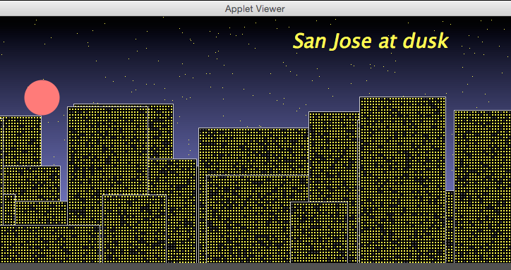
Constant variables in action
Tinker with the constants declared in NightSky (and Building too!)

Slide 10
Assignment operator: rather a simple tool . . .
Get current value of b
Get current value of c
Add two values
Assign value to a
a = b + c;
I get the value on the
right, I place it on the left.
I get the value on the
right, I place it on the left.
I get the value on the
right, I place it on the left.

Slide 11
Expressions in Assignment Statements
Expression: Any combination of constants & variables that can be evaluated to yield a result.
Examples:
sum = 4 + 6 + 9;
battingAverage = hits / 100;
a = a + 4;
Notes:
can also assign a variable the results of an expression
expression = mathematical equation
Again, works from right to left
1. Caluclate value one the right
2. Assign this value to variable on the right

Slide 12
Assignment Variations
Only one variable on the left-hand side
Can repeat it on the right-hand side
Allows us to modify existing variables
EXAMPLES
sum = sum - 5;
// calculate 5 less than sum’s value, then assign it to sum
counter = counter + 1;
// increase value stored in counter by 1.
Notes:
Note: This works with ALL ARITHMETIC OPERATORS as well
How does this work: 2 step process, just as before:
1) Calculates value of expression on right
2) Assigns it to variable on the left

Slide 13
Assignment Shorthand
If we are altering an existing variable . . .
SHORTHAND CODES:
+= -= *= /=
EXAMPLES
sum += 5;
// increase sum’s value by 5
x /= 2;
// reduce x’s value by half

Slide 14
Additional Shorthand Method
For when variable is increased or decreased by one.
Form: variable++ or variable--
int myScore = 0;
int yourScore = 0;
myScore++;
yourScore--;

Slide 15
Increment/Decrement Operators
++i Prefix increment operator
i++ Postfix increment operator
--i Prefix decrement operator
i-- Postfix decrement operator
Notes:
Both have the effect of increasing or decreasing the value by one. Prefix adds one, then carries out the rest of the statement. Postfix carries out the rest of the statement, then adds one.

Slide 16
A new mathematical operator is born: Modulus (Remainder)
The modulus sign returns the remainder of a hypothetical division problem
5 % 3 =
21 % 4 =
21 % 3 =
3 % 5 =
%
Notes:
5 % 3 = 2
21 % 4 = 1
21 % 3 = 0
3 % 5 = 3

Slide 17
Combining operators
result = 10 – 15 / 5
What happens here?
What about
result = 10 – 17 / 5
Notes:
Both equal 7
Division comes before subtraction.
In second problem, don’t forget that 17 / 5 = 3. int / int

Slide 18
Operator precedence
Operator | Operation | Associates
* / % | Multiplication Division Remainder (modulus) | L to R
+ - + | Addition Subtraction String concatentation | L to R
= | Assignment | R to L

Slide 19
Practice Questions
x = 34 – 18 % 2 * 3;
num1 = 3 * 2 % 5 – 3 * 5;
x = y + 4 = 9 – 6 * 2 % 3;
34
-14
Syntax error!

